Slide 1
Passing a Method to a Method (big concept) and Delegates (simple concept)
https://sites.google.com/site/kathyfriedrichwebpages/_/rsrc/1449556700107/home/quilts-3rd-set/Q19.JPG
https://sites.google.com/site/kathyfriedrichwebpages/_/rsrc/1449556722544/home/quilts-3rd-set/Q22.JPG
http://www.csharp-station.com/Tutorials/Lesson14.aspx

Slide 2
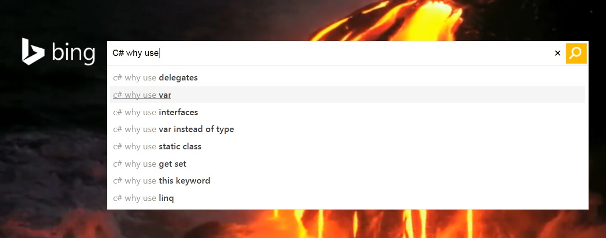

Slide 3
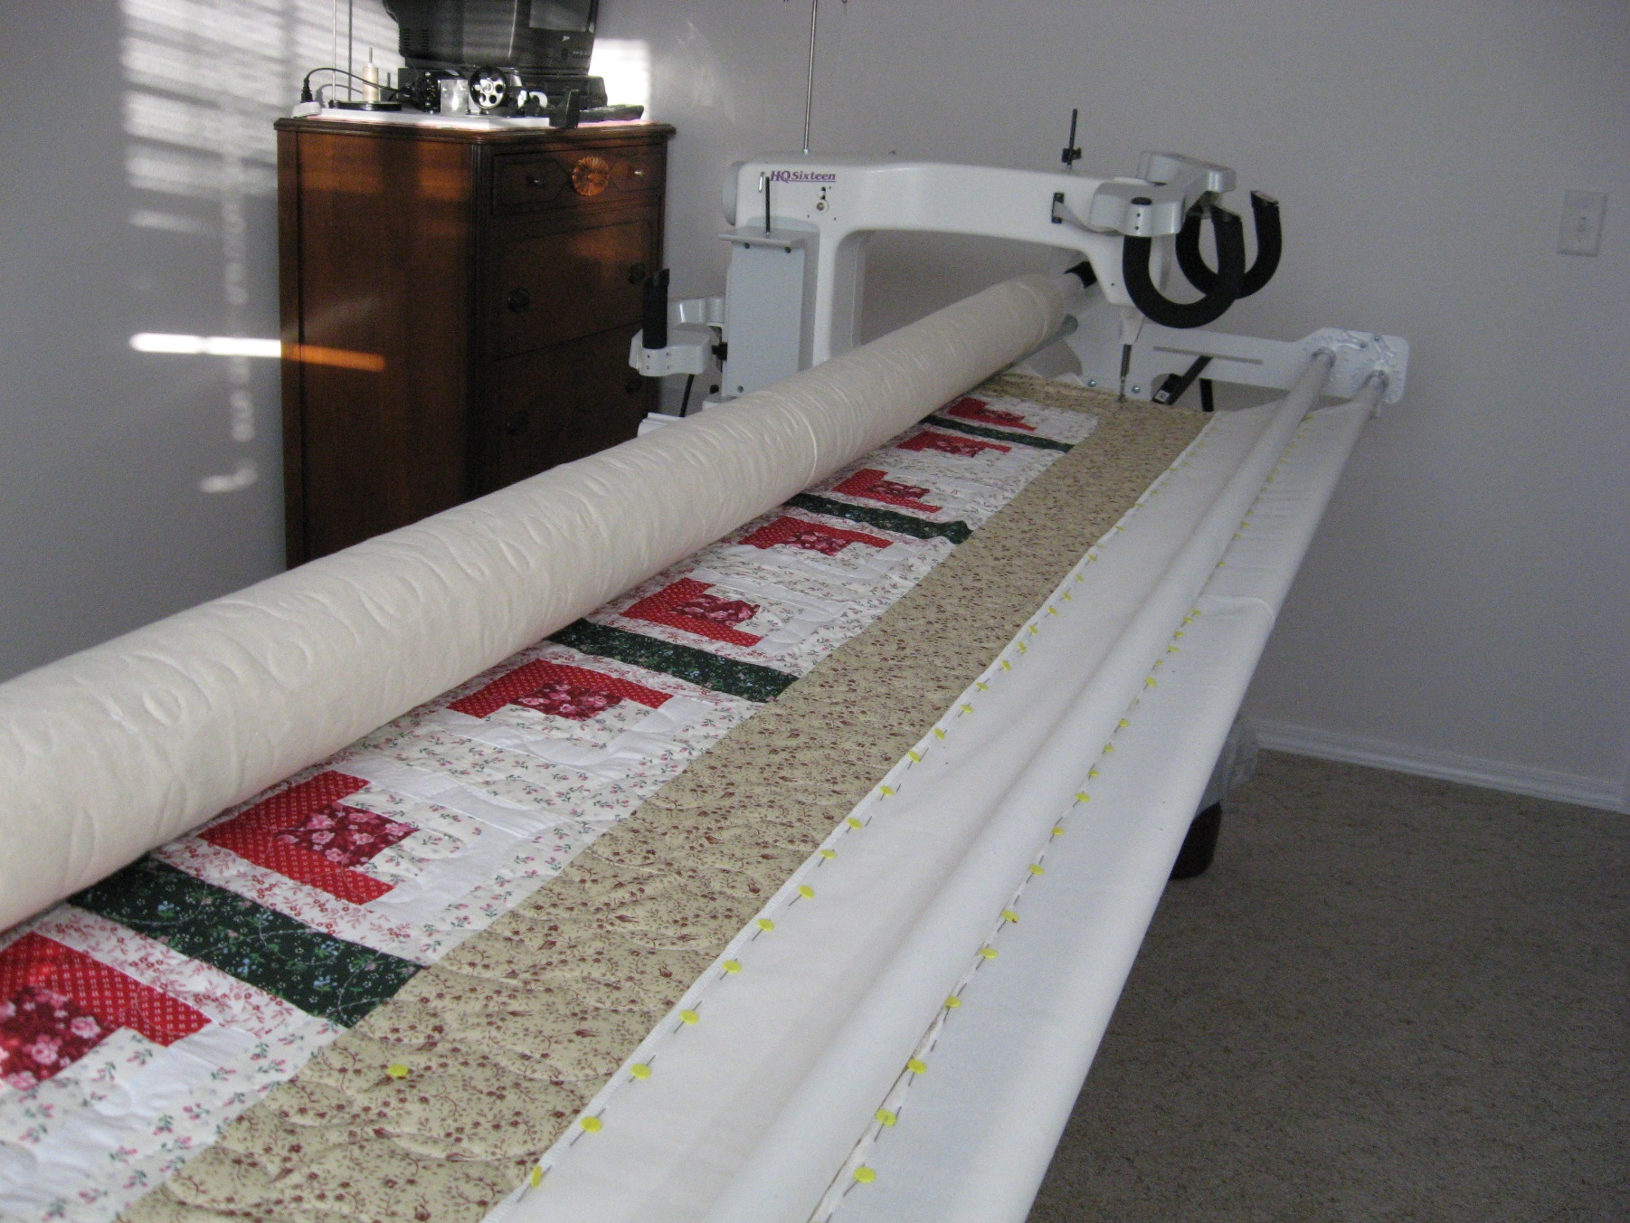
Real life “similar” examples
Quilting store has a machine that quilts a pattern.

Slide 4


The “object”, the machine, has the code (a method) to do quilting. You pass in a new “method”, a USB stick, with a pattern you like.

Slide 5
Passing methods:
User Program
Public void MakePrettyStar( )
{
Your special code to draw a star
}
Start the machine by calling
MyQuilt.QuiltThisWay(MakePrettyStar);
MyQuilt Object
QuiltThisWay(give me a method)
{
quilt code …
MakePrettyStar()
quilt code …
}

Slide 6
That is the big idea
You can write a method, and then give that method to another method and have it run your method. (JavaScript calls this a “callback”)
When you pass in a pass-in-method as a parameter to a use-your-method, as you call the use-your-method, you can set the parameter ( ) to be either:
The actual name of your pass-in-method,
Or, you can give your pass-in-method a name.
If you give a name to your pass-in-method, then that name is “of data type Delegate Method”. A Delegate method is a data type variable that is allowed to point to a method.

Slide 7
give your pass-in-method a name
If you look at a C# program, and see a variable called myVariable, what could that variable be:
An int
A string
A new data type you defined using enum
An object (from a Class or a Struct)
Could it be a name for a method?? yes

Slide 8
Yes!
Delegates allow you to create a variable that is a method call.
Say you had two methods
DrawHandsBW(computerHand, myHand);
DrawHandsColor(computerHand, myHand);
You could have a variable that was equated to the DrawHandsBW method, lets use MyMethodVar
Then, after assigning that variable, MyMethodVar, a value (MyMethodVar = DrawHandsBW)
You could write:
MyMethodVar(computerHand, myHand);
Then you could re-assign MyMethodVar to refer to another method, (MyMethodVar = DrawHandsColor)
, and then get a different result from
MyMethodVar(computerHand, myHand);

Slide 9
What did we do?
We created a variable, and instead of it pointing to an int
int foo; // foo can not hold some integer
Or pointing to a string
string foo; // foo can not hold some string
We assigned it to point to method.
DelegateDefintionX foo; // foo can now point to some method you wrote.
However, this idea of giving a method a name is a smaller part of the big idea. The big idea is passing in a method1 (some code) to another method2 so that method2 can do something specific (method1) that you tell it to.
Delegate variables just makes it easier to do that.

Slide 10
But why?
Several reasons, but the biggest is:
Just as you can pass an object into an object’s method,
myFruitList.Add(myApple1);
with delegates, you can pass a method into another object's method.
This lets you write a Class that is more general, so
You can write lots of common code, that applies to all situations, but using that same general method, give it “special directions” to handle one aspect of the general method uniquely
Remember the quilt machine, lots of instructions to move the machinery back and forth across the machine, this is done for all quilts, but to tell it what pattern to use for this particular call to the quilt method, we pass in the name of a method that knows how to make the special pattern we want for this call.
Also widely used for a general method that operates on different data types, so the user calls the method and then passes in the code that can process THAT data type

Slide 11
A use:
Think about how you use methods right now.
You write an algorithm that does its thing by manipulating the values of variables and executing its pre-written methods directly by name.
What if you wanted an algorithm that was very flexible, reusable, and allowed you to implement different functionality as the need arises?
Let's say that this was an algorithm that supported some type of data structure (int) and did something very useful with a List<int>.
But you want to make in general, so it can work on List<T> of type float, enum Temperature, enum Direction, struct Student, etc.
If you don't know what all the types are when you write this method, how could you decide how to deal with whatever data type was passed in?

Slide 12
You could implement an if/then/else or switch statement to handle well-known types, but
this would be limiting to the types you know about the day you write this method
plus there is the overhead to determine the type, going thru the switch or if statements
Instead
Pass in the type-specific code using a delegate method within your cool method
letting the method that is pointed to by the delegate, perform the appropriate operations
You are passing in code to the method that you want it to run.

Slide 13
Look at program
1-PassMethodNoDelegate

Slide 14
But it’s a bit more complicated
When you created a new data type, an enum, you did not say enum.heart
You defined a new data type in the enum family first, Suit
Then using that new type Suit, you can say Suit.heart
Delegates work that way, first your define a new member of this family, a new type of delegate, giving that your own name (e.g. TriMethods) and then when you want to define a delegate method name, you use that “type”. See next slide.

Slide 15
Delegate: a new data type, which is a specification of a method signature
public delegate void QuiltPattern(int width);
Delegate variable: just a variable of “type” your-delegate, with any name you like. QuiltPattern myPattern;
Your “here’s the code I want you to execute”, which is a normal method definition, with any name you like, but whose signature must match the Delegate definition. (you can have more than one method defined that meet the spec.)
public void StarPattern(int width)
{ code }
Assign a value to your Delegate variable , similar to
String myName;
myName = “Kurt”;
QuiltPattern myPattern;
myPattern = StarPattern; //new name for your method

Slide 16
That was one half of the story;
The normal use is, you use that Delegate variable myPattern (which is a pointer to some real method you wrote)
And you pass that in as an parameter to some other method. This other method will then, at some point in its code path, call your method
ExecuteQuiltPattern(“red", 34, myPattern);
Then the code in the ExecuteQuiltPattern …
public void ExecuteQuiltPattern(string color, int size, QuiltPattern passedInMethod)
{
code …
passedInMethod(size); //call back to your defined method
code …
}

Slide 17
You create a new data type using the delegate key word
public delegate void ProvideGreeting(string name);
That delegate definition is a contract published by the method that WANTS a method passed it, specifying what the signature of the method must be as you pass one in to it.

Slide 18
Using a Delegate: quite a few steps
Define a Delegate, specifying a signature that a compliant method must adhere to; the format required by the quilt machine method WriteGreetingsMethod(give me a method)
public delegate void ProvideGreeting(string name);
Implement one or more methods that match the specified signature to fulfill the type definition
public static void GoodMorning(string name) { … }
public static void GoodAfternoon(string name) { … }
public static void GoodNight(string name) { … }
Then define a “delegate variable” of type “your Delegate”
ProvideGreeting myGreetMethod;
Then assign one of the compatible methods to your variable
myGreetMethod = GoodAfternoon;
Call the method: WriteGreetingsMethod(myGreetMethod)
Same thing: WriteGreetingsMethod(GoodAfternoon)

Slide 19
One more time!

Slide 20
Contract between class that wants to use it and defining method
public delegate int Comparer(object obj1, object obj2); //delegate declaration
class Program
static void Main(string[] args)
{
NameBank ourNames = new NameBank(); //object instantiation
Comparer cmp1 = CompareFirstNames; //delegate instantiation
…
ourNames.Sort(cmp1);
…
}
//delegate method that satisfies definition, does what you want it to
public static int CompareFirstNames(Name name1, Name name2)
{
code; // your special code your want to pass into some other object
}
class NameBank //class can be used in lots of other classes
…
//class provides a Sort method, but requires you to tell it how to sort
public void Sort(Comparer compare) //requires you to pass in a method
{
…
if (compare(names[i], names[j]) > 0)
…
}

Slide 21
Contract between class that wants to use it and defining method
public delegate int Comparer(object obj1, object obj2); //delegate declaration
class Program
static void Main(string[] args)
{
NameBank ourNames = new NameBank(); //object instantiation
Comparer cmp1 = CompareFirstNames; //delegate instantiation
…
ourNames.Sort(cmp1);
…
}
//delegate method that satisfies definition, does what you want it to
public static int CompareFirstNames(Name name1, Name name2)
{
code; // your special code your want to pass into some other object
}
class NameBank //class can be used in lots of other classes
…
//class provides a Sort method, but requires you to tell it how to sort
public void Sort(Comparer compare) //requires you to pass in a method
{
…
if (compare(names[i], names[j]) > 0)
…
}

Slide 22
If you had this method defined:
private static void CheckNameLength(string passedInName)
{
wonderfull code;
}
string firstName = "Bob";
You can call it either way:
CheckNameLength(firstName);
CheckNameLength("Bob");

Slide 23
Delegate variable
You don’t need to create a delegate variable …
If you have a delegate definition
You have a method the matches that definition
You have some other class that has a method defined that takes in a parameter of that delegate definition,
Then
You can just pass the name of your method in directly to the other class’s method, without first making up a delegate variable to hold a pointer to your method.

Slide 24
Look at programs
2-DelegatesAnotherExample
3-DelegatesPersonFilter

Slide 25
Slides for Part 2

Slide 26
Multi-cast Delegates
A delegate instance can refer to multiple methods
myGreetMethod = GoodAfternoon;
myGreetMethod = + GoodNight;
myGreetMethod will call both methods.
myGreetMethod("Kurt");
(this will be important when we get to Events)

Slide 27
http://zetcode.com/lang/csharp/delegates/
There is nothing that is done with delegates that cannot be done with regular methods. Delegates are used because they bring several advantages.
They foster flexibility of the application and code reuse.
Like interfaces, delegates let us decouple and generalize our code.
Delegates provide a way of specializing behavior of a class without subclassing it.
General Classes may have complex generic behavior but are often coded to specialized data structures or algorithm definitions.
Instead, Classes can stay more generic but then deal with specialization either through
Inheritance : add or overwrite the parents parameters and methods in the sub-class definitions, or
Delegates : leave the class generic, but set it up to take in “extra instructions” from a calling method

Slide 28
Common Uses
Events
Callbacks
Extension methods
Event
Events allow you to specify that when external event occurs, such as a mouse click, which is in some other code, “please do this code for me”. (this, is the delegate method you give it)
Events are most commonly used in user interfaces such as Windows Forms. (Other events can be raised without direct user action, such as events that correspond to timer ticks of the internal clock, email being received, file-copy operations completing, etc. )
Events and delegates are tightly coupled concepts because flexible event handling requires that the response to the event be dispatched to the appropriate event handler. An event handler is typically implemented in C# via a delegate.
YOU get to write the code that the event handler should execute so that the event processor will do whatever you want. You do this by passing in your method (delegate) telling it what to do

Slide 29
Callbacks: used for asynchronous behavior
http://www.codeproject.com/Articles/426120/Calling-a-method-in-Csharp-asynchronously-using-de
(Pretty much assume multiple thread coding.)
Delegates give us the ability to execute a method asynchronously.
That is, through a delegate, you can begin invocation of a method and then return immediately while the delegate executes its method in a separate thread. Your page execution does not need to wait for that method to complete.

Slide 30
Common Uses
Extension methods let you basically add a new method definition to an existing Class, without having to re-code the class, recompile, and redistribute. Many extension methods make use of delegates
LINQ: In the LINQ extensions to the C# language, delegate methods are extensively used. Query expressions (such as select statements) are implemented with methods that receive delegates.

